Slide 1
Unit 10 Pattern Recognition
Prepared By
Er.Harendra Bikram Shah
(Lecturer)
Department of Computer Engineering

Slide 2
OUTLINES
Introduction to Pattern Recognition
Applications of Pattern Recognition
Components or working of Pattern Recognition

Slide 3
Introduction to Pattern Recognition
Pattern is a design or human brain idea or abstract ideas.
Classification of input data on the basis of certain features from a noisy data.
Pattern recognition can be defined as the classification of data based on knowledge already gained.

Slide 4
Applications of Pattern Recognition
Image processing, segmentation, and analysis
Computer vision
Seismic analysis
Radar signal classification/analysis
Speech recognition
Fingerprint identification
Engineering
Astronomy
Geography

Slide 5
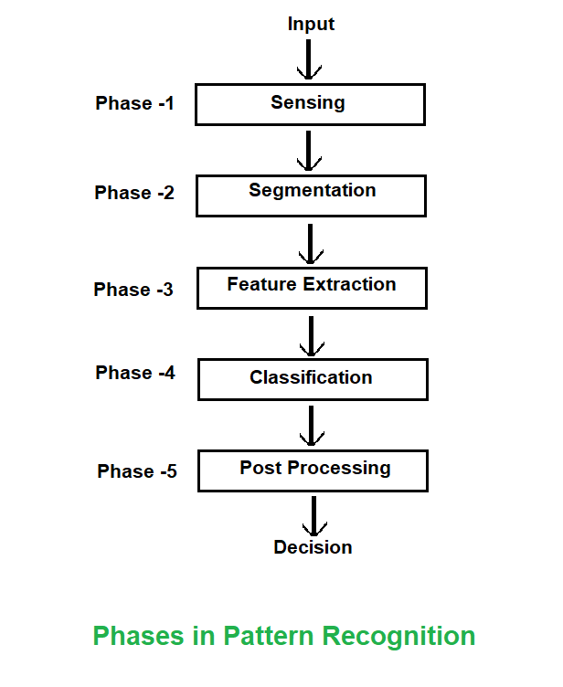
Components or working or phases of Pattern Recognition

Slide 6
End of UNIT 10

Slide 7
End of Syllabus

